Slide 1
IB Language and Literature
Overview of Course Aims
and Concepts

Slide 2
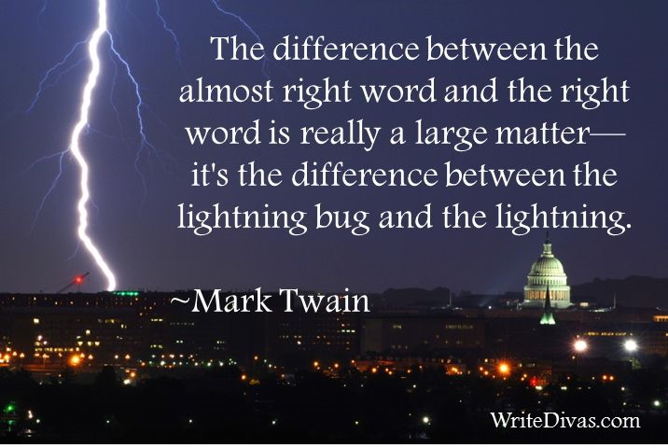
In this course, we will consider the power of words and language.

Slide 3
We will study full length literary texts

Slide 4
However, for the first unit, much of our time will be devoted to studying other kinds of “TEXTS”
This means we will need to redefine the idea of a “text.”
In this class, we consider a text to be anything, which may be “read” or interpreted and analyzed in terms of what it communicates.

Slide 5
Examples of texts will include…

Slide 6
Print Advertisements

Slide 7
Commercials

Slide 8
Cartoons

Slide 9
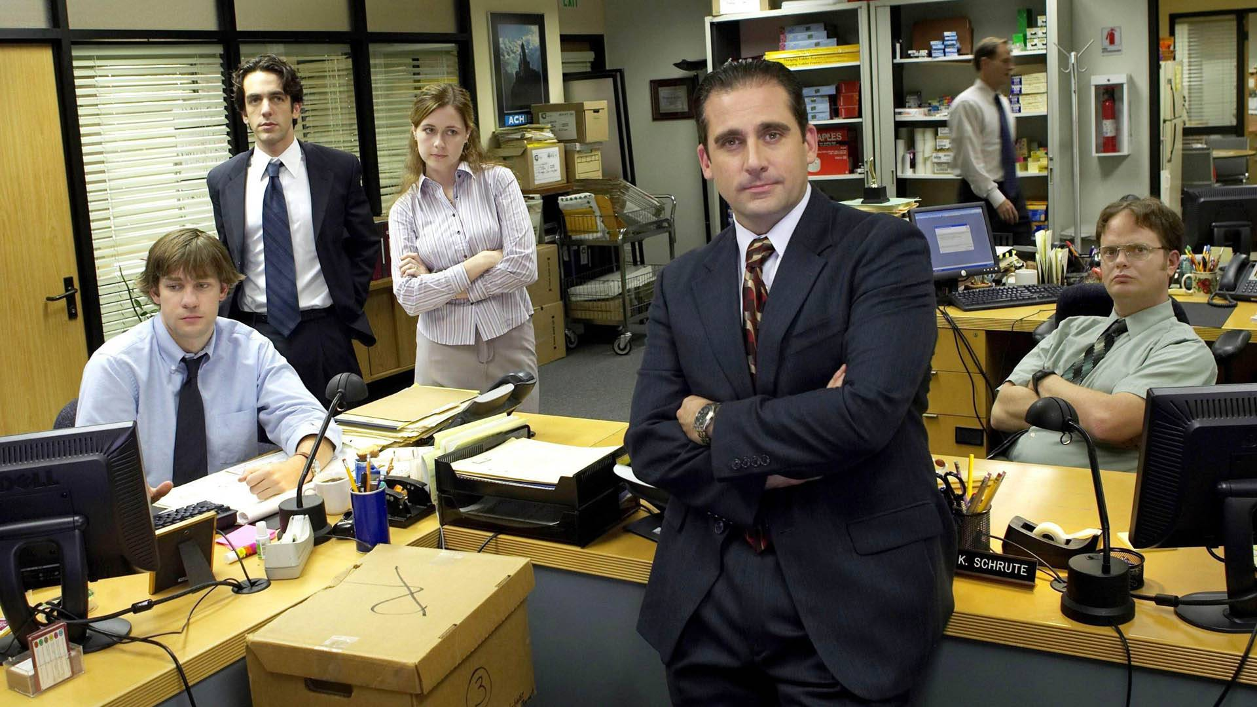
Television Shows

Slide 10
Movies

Slide 11
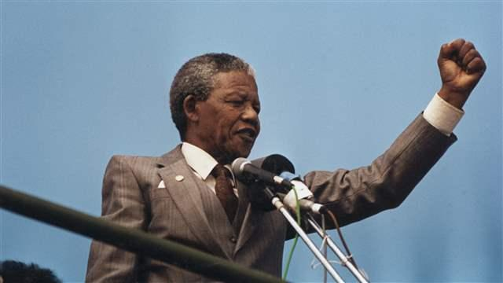
Speeches

Slide 12
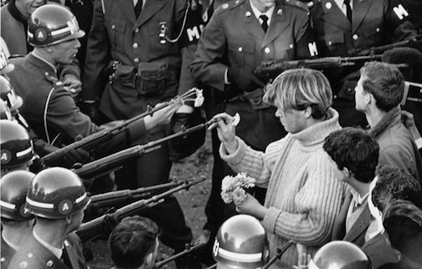
Photographs

Slide 13
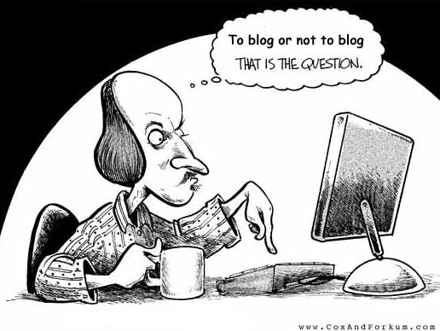
Blogs

Slide 14
Songs

Slide 15
Posters

Slide 16
Through all these types of texts we will explore questions like…

Slide 17
What are the ways we communicate?
Do texts have an aim?
How can language influence our points of view?
How are groups of people portrayed in different ways?
Is advertising made to shock us or manipulate us into a certain way of thinking?
Do new technologies change our views?
How powerful is pop culture in shaping who we are?
How has language evolved throughout history?
Is language powerful enough to change the world?

Slide 18
In IB Language and Literature you will develop…
a personal appreciation of language and literature
skills in literary criticism using a range of texts from different periods, styles and genres
an understanding of the formal, stylistic and aesthetic qualities of texts
an appreciation of cultural differences in perspective
an understanding of how language challenges and sustains ways of thinking.
strong powers of expression, both written and oral

Slide 19
The course is divided into four parts, which will be covered over two years:

Slide 20
1: Language in a Cultural Context
Students will examine the influence of a variety of contexts on language usage and change, examining the relationship between language and a range of identities.
Topics will include the history of the English language, including a focus on language death, the links between language use, power and status, language and taboo, and contemporary debates over language use.

Slide 21
2: Language and Mass Communication
During this unit, students will consider a range of issues to do with the ways mass media, such as newspapers, magazines and television, influence consumers’ responses to events and attitudes to topics.
They will examine political speeches and propaganda, and explore the gate keeping roles played by the media, as well as producing their own media texts which utilize appropriate conventions.

Slide 22
3: Literature: Texts and Contexts
In this unit, students will be invited to reflect on how different readers at different times, or from different cultures and backgrounds, might respond to the texts.
They will examine the texts from different perspectives, such as gender or power.

Slide 23
4: Literature: Critical Study
In this unit, students will undertake close study and detailed analysis of the writer’s craft, and explore themes, values and moral stances within the texts.

Slide 24
Assessment There are four ways in which students will be assessed during the course.

Slide 25
Further Oral Activities
Throughout the 1st half of the year, students will engage in spoken activities in the classroom, such as group or individual presentations. These will be assessed by the teacher, with marks moderated externally.

Slide 26
Written Tasks
During the course, students will produce several written tasks, which are drafted coursework pieces. Examples of written tasks might include an additional chapter for a novel studied or an analysis of how an advertisements might be interpreted by two different viewers.
These are assessed internally, with marks moderated externally.

Slide 27
Individual Oral Commentary
During the second year of the course, students will complete an assessment where they will be asked to give a commentary on a section from one of their Part 4 Literature texts.

Slide 28
Examination
Students will sit for two examinations at the end of the course (senior year).
The first examination, Paper 1, will ask students to analyze an unseen text or texts.
The second, Paper 2, will ask students to write about their Part 3 Literature texts in relation to
a set question.

Slide 29
THE POWER OF LANGUAGE https://www.youtube.com/watch?v=Wgi0t2ap-us
This video was inspired by a short story. How does the video communicate ideas differently than the original story would? How is it different than words on a page? Consider all the elements of this kind of “text” that are not present in a written text.

Slide 30
What did she write on the sign?

Slide 31
What does this convey to you about the power of language?

Slide 32
THE POWER OF WORDS https://www.youtube.com/watch?v=XVY4DeAvnfI

